Slide 1

Monitoring and Logging:
Pivotal Container Service
Fall 2018
© Copyright 2018 Pivotal Software, Inc. All rights Reserved.

Slide 2
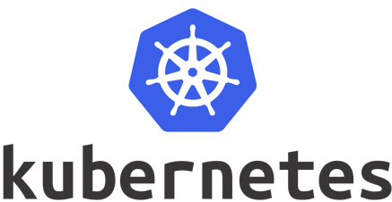
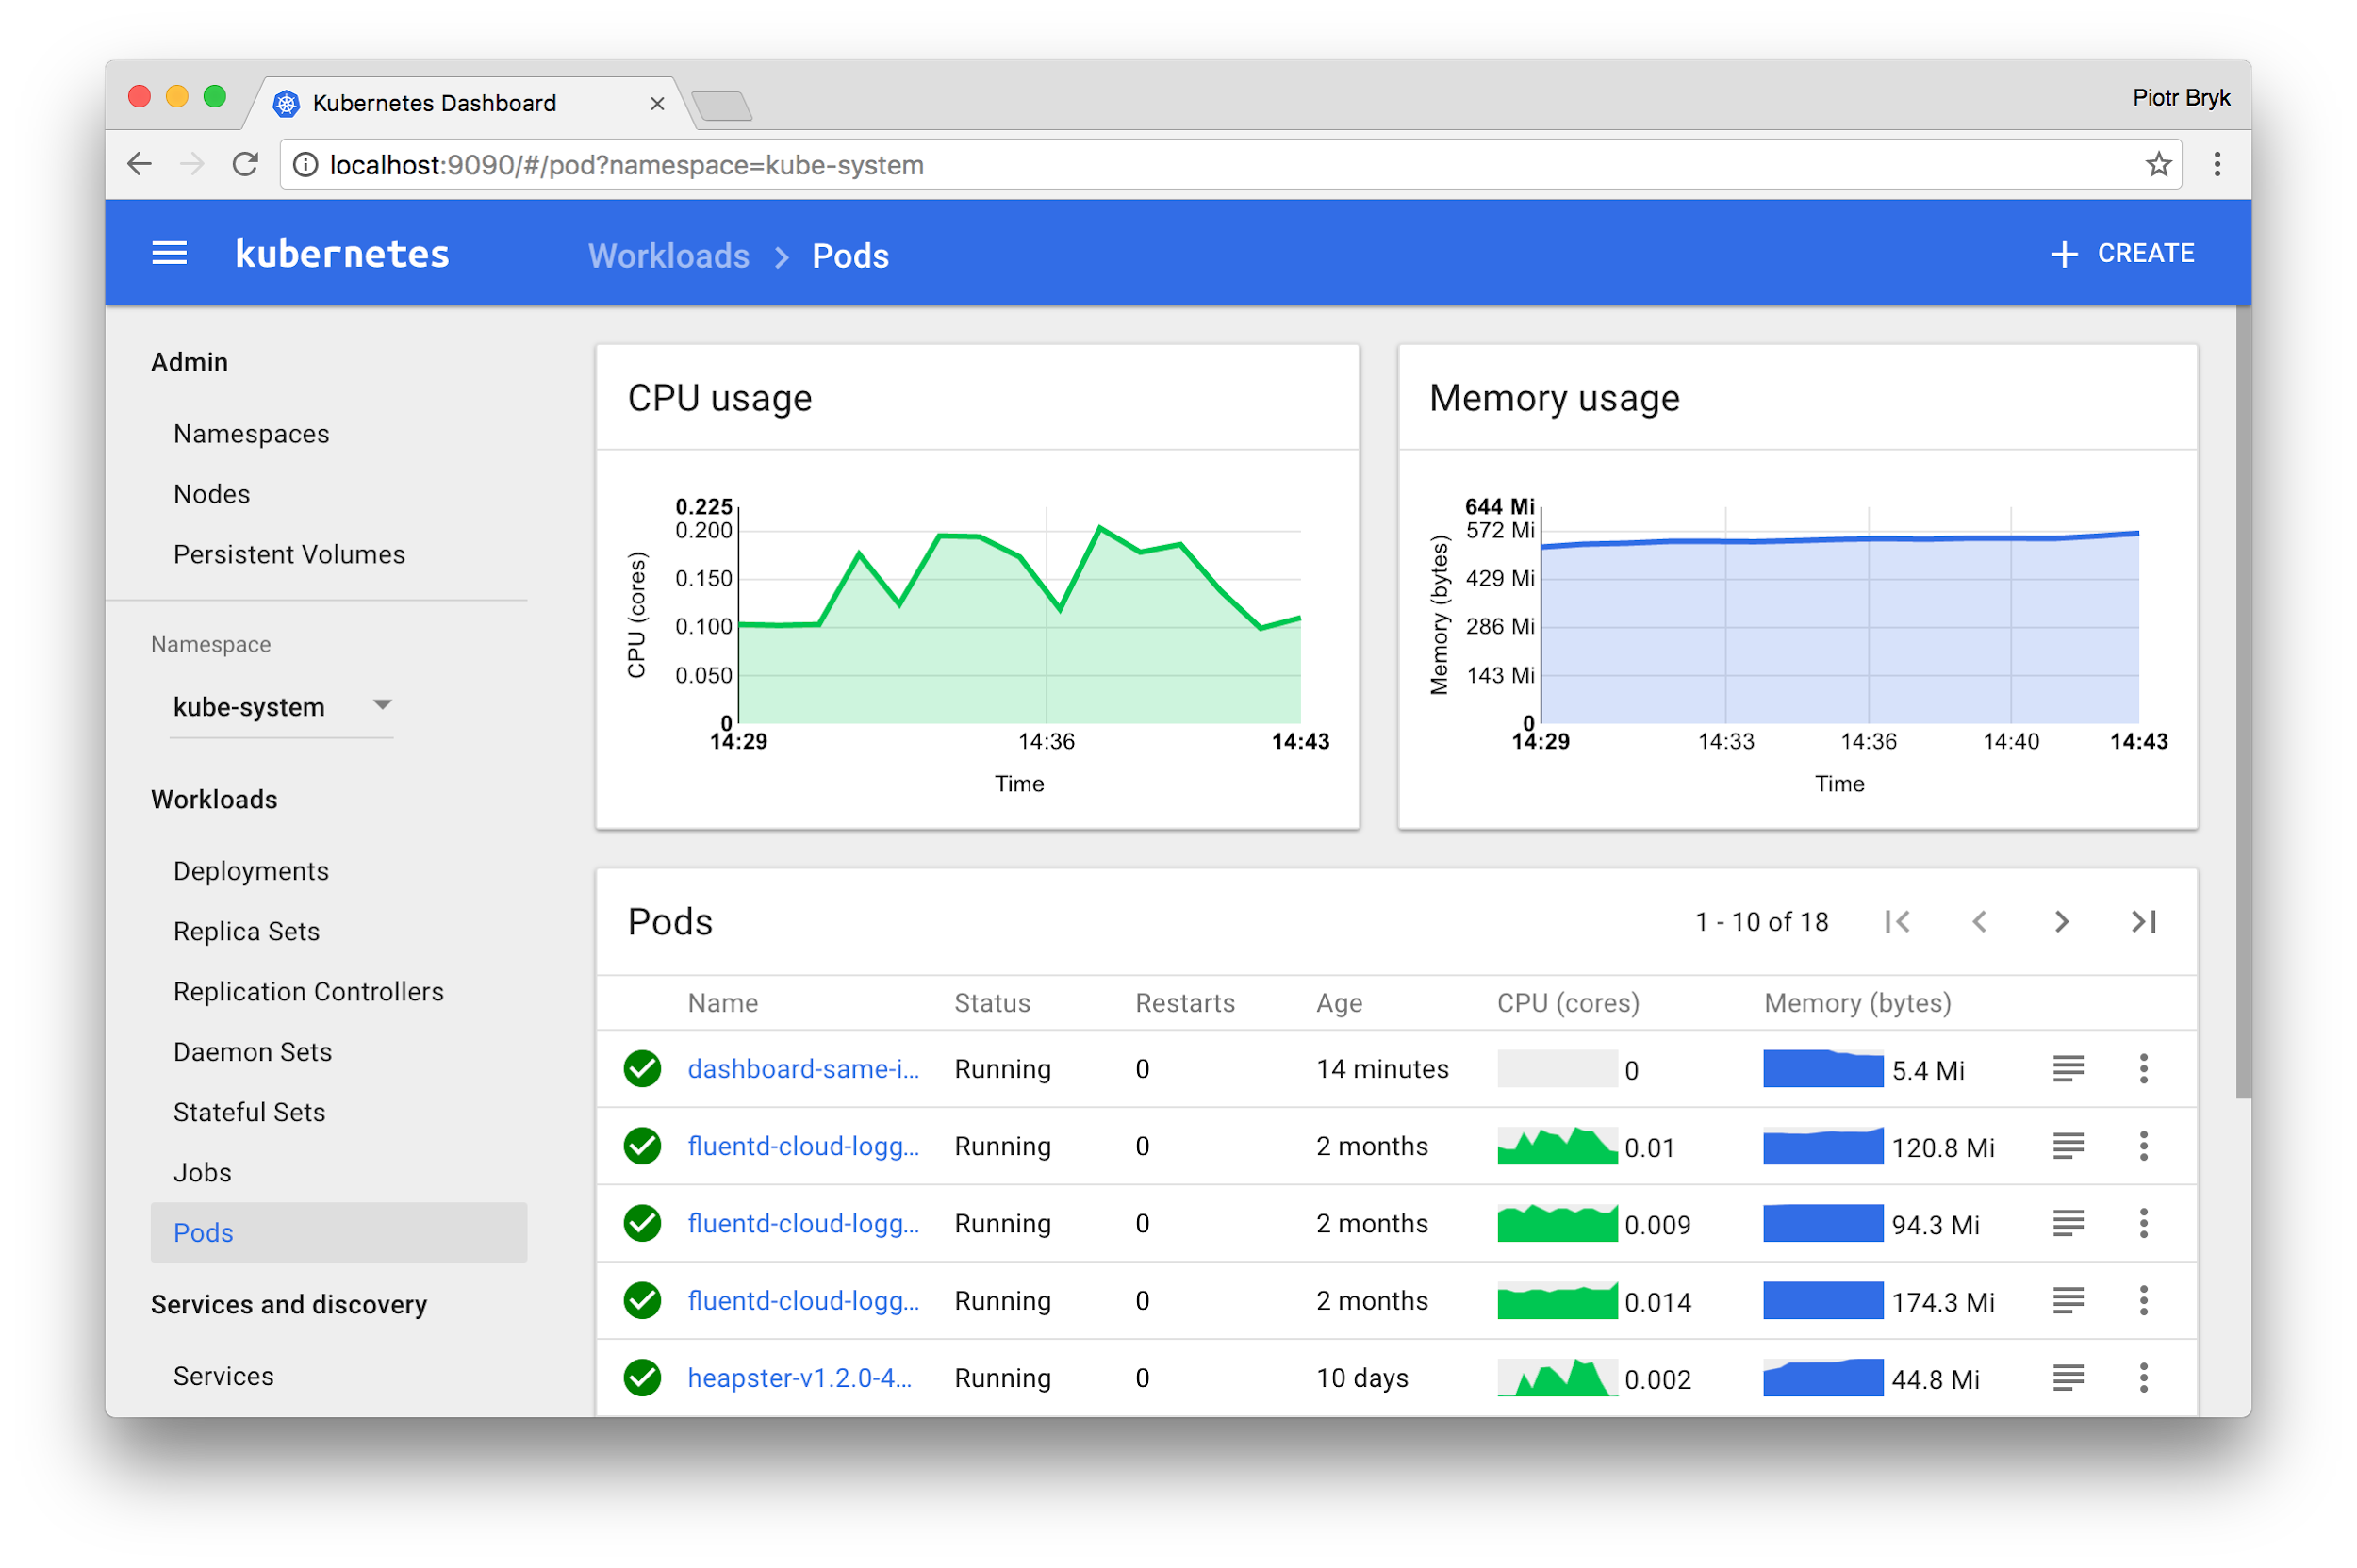
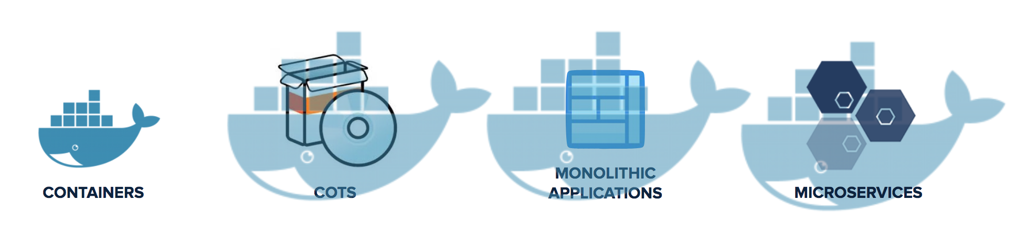
Kubernetes is a Runtime for Containerized Workloads
App User
Dev / Apps
IT / Ops
> kubectl
Kubernetes Dashboard
Compute
Storage
Networking

Slide 3
...but Kubernetes alone is not enough for enterprises
App User
Load Balancing / Routing
Dev / Apps
IT / Ops
Container Image
Registry
External
Data Services
> kubectl
Command Line / API
App Monitoring
Cluster Provisioning
App Logging
Management GUI
Kubernetes Dashboard
Monitoring GUI
OS Updates
K8S Updates
Log & Monitor
Backup & Restore
OS Images
K8S Images
Recover & Restart
Provision & Scale
Compute
Storage
Networking

Slide 4
App User
Load Balancing / Routing
Dev / Apps
Container Image
Registry
IT / Ops
External
Data Services
> kubectl
Command Line / API
App Monitoring
Cluster Provisioning
App Logging
Management GUI
Kubernetes Dashboard
Monitoring GUI
OS Updates
K8S Updates
Log & Monitor
Backup & Restore
OS Images
K8S Images
Recover & Restart
Provision & Scale
Compute
Storage
Networking

Slide 5
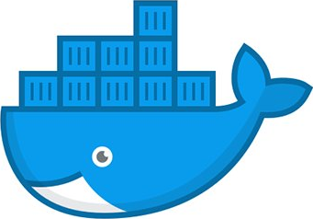
PKS Health Management
Kubelet watches and restart containers
Availability Zone B
Bosh director watches and restarts nodes
Availability Zone A
Bosh agent watches and restarts processes
Bosh distributes deployments across AZ’s
K8s Master
Controller Manager
Kube Scheduler
Availability Zone B
API Server
Availability Zone A
Bosh agent
K8s Worker
Kubelet
Pod
Pod
Kube-proxy
Pod
Bosh Health Manager
Bosh agent

Slide 6
App User
Load Balancing / Routing
Dev / Apps
Container Image
Registry
IT / Ops
External
Data Services
> kubectl
Command Line / API
App Monitoring
Cluster Provisioning
App Logging
Management GUI
Kubernetes Dashboard
Monitoring GUI
OS Updates
K8S Updates
Log & Monitor
Backup & Restore
OS Images
K8S Images
Recover & Restart
Provision & Scale
Compute
Storage
Networking

Slide 7
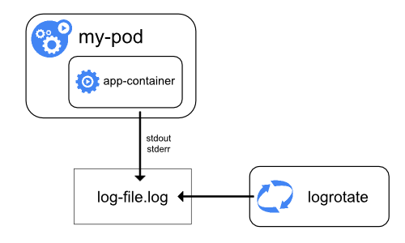
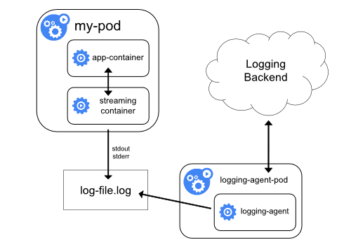
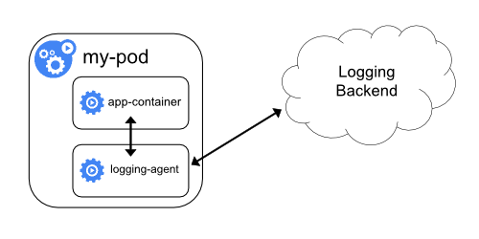
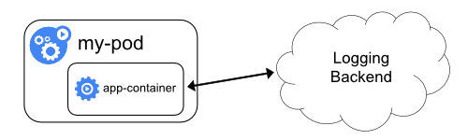


Kubernetes Logging Architectures
Node Level Logging
Cluster Level Node Logging Agent
Cluster Level
Sidecar Container with Logging Agent
Cluster/Namespace Level
Exposing Logs Directly

Slide 8

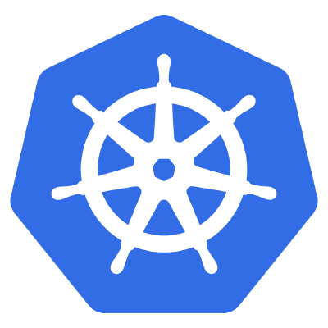
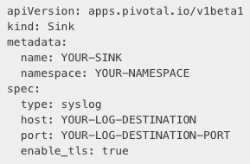
Namespace or Cluster Sinks
Cluster Admin Creates Sink
Apply to namespace
kubectl apply -f sink.yml
apiVersion: apps.pivotal.io/v1
kind: Sink
sink.yml
Namespace A
sink:syslog://
Namespace B
sink:syslog://
Kubernetes Cluster
Notes:
•Developers Or Operators can define syslog endpoints
•Namespace or Cluster level Sinks
•Implemented as K8s CRDs
•
•Multi Tenancy
•Unique Log destination per team
•Developers Or Operators can use log tools of their choice

Slide 9


LogInsight by VMware Integration
Cluster Admin Creates Sink
apiVersion: apps.pivotal.io/v1
kind: Sink
Application Logging End To End
POD
POD
Namespace A
POD
sink:syslog://
Namespace B
POD
POD
POD
sink:syslog://
Kubernetes Cluster
vRLI
Dev Team Access Logs
Notes:
•Developers Or Operators can define syslog endpoints
•Namespace or Cluster level Sinks
•Implemented as K8s CRDs
•
•Multi Tenancy
•Unique Log destination per team
•Developers Or Operators can use log tools of their choice

Slide 10
Log Types
BOSH Syslogs
PKS API Server Logs
K8s Node Logs
NSX-T Logs
ESXi Logs
VREALIZE IS AWESOME AND CAN GRAB ALL THOSE!
Other logging considerations

Slide 11
